Slide 2
Overview
Part1 - Introduction
Design Topics
Design hierarchy
Design Procedure
The major design steps: specification, formulation, optimization, technology mapping, and verification
Technology Mapping
From AND, OR, and NOT to other gate types
Decoders
Part 2
Encoders
Multiplexers
Binary Adders

Slide 3
Combinational Circuits
A combinational logic circuit has:
A set of m Boolean inputs,
A set of n Boolean outputs, and
n switching functions, each mapping the 2^{m} input combinations to an output such that the current output depends only on the current input values
A block diagram:
Combinatorial
Logic
Circuit
m Boolean Inputs
n Boolean Outputs

Slide 4
Hierarchical Design
To control the complexity of the function mapping inputs to outputs:
Decompose the function into smaller pieces called blocks
Decompose each block’s function into smaller blocks, repeating as necessary until all blocks are small enough
Any block not decomposed is called a primitive block
The collection of all blocks including the decomposed ones is a hierarchy
Example: 9-input parity tree (see next slide)
Top Level: 9 inputs, one output
2nd Level: Four 3-bit odd parity trees in two levels
3rd Level: Two 2-bit exclusive-OR functions
Primitives: Four 2-input NAND gates
Design requires 4 X 2 X 4 = 32 2-input NAND gates

Slide 5
Hierarchy for Parity Tree Example
X
0
X
1
X
2
9-Input
X
3
odd
X
Z
4
O
X
function
5
X
X
A
6
0
0
3-Input
X
7
A
odd
X
X
1
B
8
1
function
O
(a) Symbol for circuit
X
A
2
2
X
3
A
A
0
3-Input
0
3-Input
X
A
odd
B
A
odd
B
Z
4
1
function
O
1
function
O
O
X
A
A
5
2
2
X
A
6
0
3-Input
X
A
odd
B
7
1
function
O
X
A
8
2
(b) Circuit as interconnected 3-input odd
function blocks
A
0
A
B
1
O
A
2
(c) 3-input odd function circuit as
interconnected exclusive-OR
blocks
(d) Exclusive-OR block as interconnected
NANDs

Slide 6
Design Example
Specification
BCD to Excess-3 code converter
Transforms BCD code for the decimal digits to Excess-3 code for the decimal digits
BCD code words for digits 0 through 9: 4-bit patterns 0000 to 1001, respectively
Excess-3 code words for digits 0 through 9: 4-bit patterns consisting of 3 (binary 0011) added to each BCD code word
Implementation:
multiple-level circuit
NAND gates (including inverters)

Slide 7
Design Example (continued)
Formulation
Conversion of 4-bit codes can be most easily formulated by a truth table
Variables - BCD: A,B,C,D
Variables - Excess-3 W,X,Y,Z
Don’t Cares - BCD 1010 to 1111

Slide 8
Design Example (continued)
C
C
Optimization
2-level using K-maps
W = A + BC + BD
X = C + D + B
Y = CD +
Z =
z
y
1
1
1
1
0
1
3
2
0
1
3
2
1
1
1
1
4
5
7
6
B
4
5
7
6
B
X
X
X
X
X
X
X
X
A
12
13
15
14
A
12
13
15
14
1
X
X
1
X
X
B
B
C
D
8
9
11
10
8
9
11
10
D
D
C
D
D
x
C
C
w
1
1
1
0
1
3
2
0
1
3
2
1
1
1
1
4
5
7
6
B
4
5
7
6
B
X
X
X
X
X
X
X
X
A
12
13
15
14
A
12
13
15
14
1
X
X
1
1
X
X
8
9
11
10
8
9
11
10
D
D

Slide 9
Design Example (continued)
Optimization (continued)
Multiple-level using transformations W = A + BC + BD X = C + D + B Y = CD + Z = G = 7 + 10 + 6 + 0 = 23
Perform extraction, finding factor:
T₁ = C + D W = A + BT₁ X = T₁ + B Y = CD + Z = G = 2 + 1 + 4 + 7 + 6 + 0 = 19
B
B
C
D
C
D
D
B
C
D
C
D
D

Slide 10
Design Example (continued)
Optimization (continued)
Multiple-level using transformations T₁ = C + D W = A + BT₁ X = T₁ + B Y = CD + Z = G = 19
An additional extraction not shown in the text since it uses a Boolean transformation: ( = C + D = ):
W = A + BT₁ X = T₁ + B Y = CD + Z = G = 2 +1 + 4 + 6 + 4 + 0 = 16!
B
C
D
C
D
D
C
D
T₁
B
T₁
T₁
D

Slide 11
Design Example (continued)
Technology Mapping
Mapping with a library containing inverters and 2-input NAND, 2-input NOR, and 2-2 AOI gates
A
W
B
X
C
Y
D
Z

Slide 12
Decoding
Decoding - the conversion of an n-bit input code to an m-bit output code with n ≤ m ≤ 2^{n} such that each valid code word produces a unique output code
Circuits that perform decoding are called decoders
Here, functional blocks for decoding are
called n-to-m line decoders, where m ≤ 2^{n}, and
generate 2^{n} (or fewer) minterms for the n input variables

Slide 13
Decoder Examples
1-to-2-Line Decoder
2-to-4-Line Decoder
Note that the 2-4-line made up of 2 1-to-2- line decoders and 4 AND gates.

Slide 14
Decoder with Enable
In general, attach m-enabling circuits to the outputs
See truth table below for function
Note use of X’s to denote both 0 and 1
Combination containing two X’s represent four binary combinations
Alternatively, can be viewed as distributing value of signal EN to 1 of 4 outputs
In this case, called a demultiplexer

Slide 15
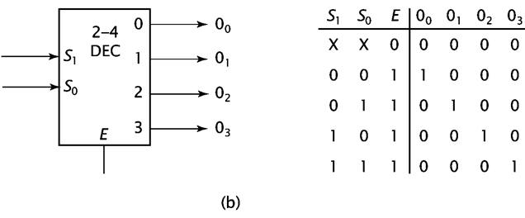
2-to-4 Decoder Diagram

Slide 16
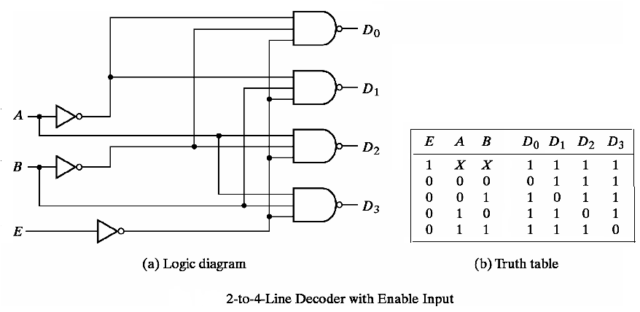
NAND Only

Slide 17
Decoder Expansion
General procedure given in book for any decoder with n inputs and 2^{n} outputs.
This procedure builds a decoder backward from the outputs.
The output AND gates are driven by two decoders with their numbers of inputs either equal or differing by 1.
These decoders are then designed using the same procedure until 2-to-1-line decoders are reached.
The procedure can be modified to apply to decoders with the number of outputs ≠ 2^{n}

Slide 18
3-to-8-line decoder (without enable)
Consider a 3-to-8-line decoder (without enabler)
A2 | A1 | A0 | D0 | D1 | D2 | D3 | D4 | D5 | D6 | D7
0 | 0 | 0 | 1
0 | 0 | 1 |  | 1
0 | 1 | 0 |  |  | 1
0 | 1 | 1 |  |  |  | 1
1 | 0 | 0 |  |  |  |  | 1
1 | 0 | 1 |  |  |  |  |  | 1
1 | 1 | 0 |  |  |  |  |  |  | 1
1 | 1 | 1 |  |  |  |  |  |  |  | 1

Slide 19
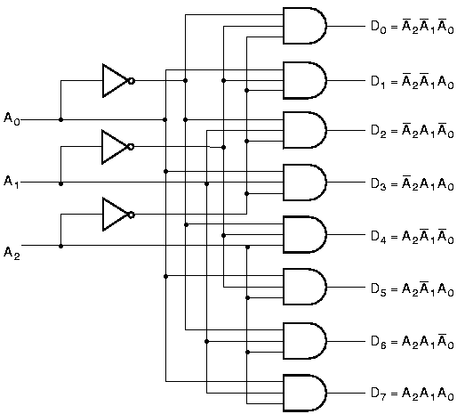
3-to-8-line Decoder Implementation

Slide 20
Easier way by Expansion
Decoder expansion
Combine two or more small decoders with enable inputs to form a larger decoder
3-to-8-line decoder constructed from two 2-to-4-line decoders
The MSB is connected to the enable inputs
if A₂=0, upper is enabled; if A₂=1, lower is enabled.

Slide 21
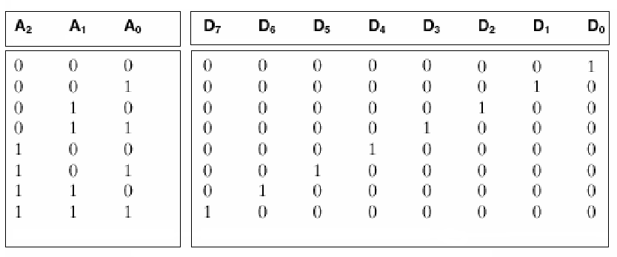
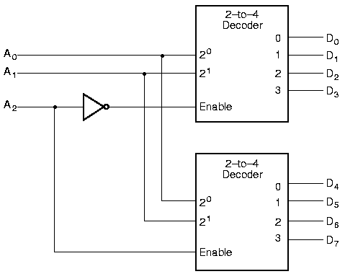
Expansion

Slide 22
Combinational Circuit Design with Decoders
Combinational circuit implementation with decoders
A decoder provide 2^{n} minterms of n input variables
Since any Boolean function can be expressed as a sum of minterms, one can use a decoder and external OR gates to implement any combinational function.

Slide 23
Combinational Circuit Design with Decoders
Realize F (X,Y,Z) = Σ (1, 4, 7) with a decoder:

Slide 24
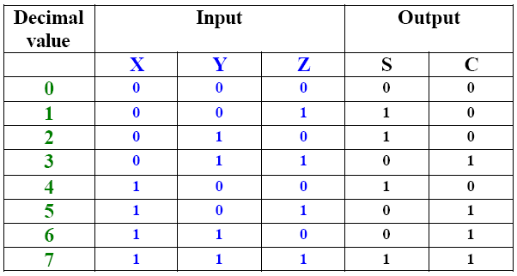
Decoder Implementation of a Full Adder
Truth Table: We have two outputs, called S, which stands for sum, and C, which stands for carry. Both sum and carry are functions of X, Y, and Z.

Slide 25

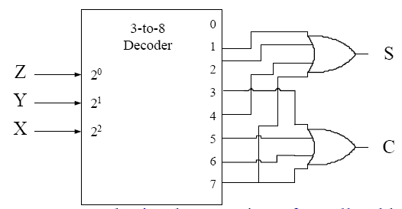
Decoder Implementation of a Full Adder
The output functions S & C can be expressed in sum-of-minterms forms as follows:
S is implemented by taking minterms 1, 2, 4, and 7 and the OR gates forms the logical sum of minterm for S
Similarly, carry C is implemented by taking logical sum of minterms 3, 5, 6, and 7 from the same decoder

